Slide 1
Presentation on informatica Power Center project
CREDIT CARD MANAGEMENT SYSTEM
PISINI CHAKRADHAR

Slide 2
INTRODUCTION
Credit Card Management System (CCMS) application:
A credit card is a payment card issued to users as a system of payment. It allows the cardholder to pay for goods and services based on the holder's promise to pay for them.
We are building a data warehouse which will keep the all records of customers , branch details ,time and transactional details of credit cards for future analysis.

Slide 3
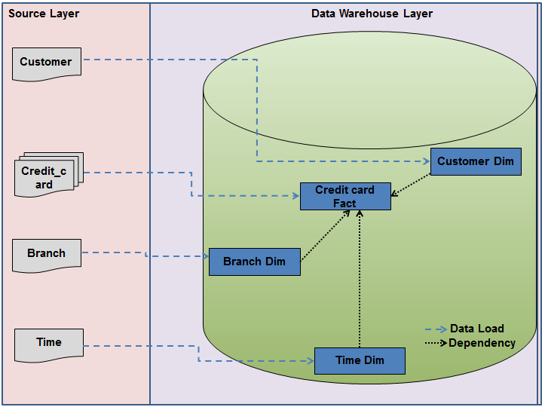
Logical Structure:
Here we have 4 sources and with them we have to build the Data Warehouse with 3 Dimensions and 1 Fact Table.

Slide 4
About Sources
4 Sources as flat files in .txt format
Naming Branch_Details , Customer_Details , Time_Details, Credit_Card_Details
All the data is generated modified by our group

Slide 5
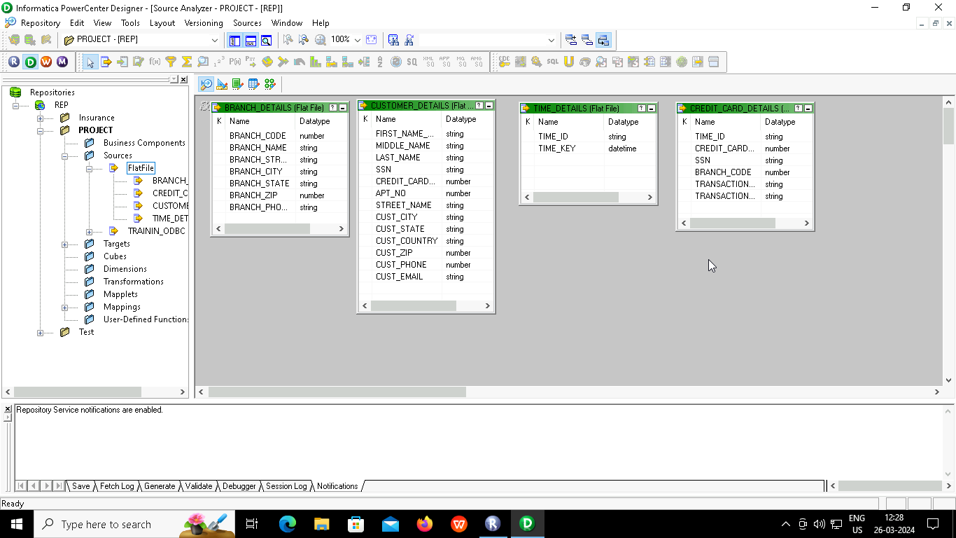
Source objects

Slide 6
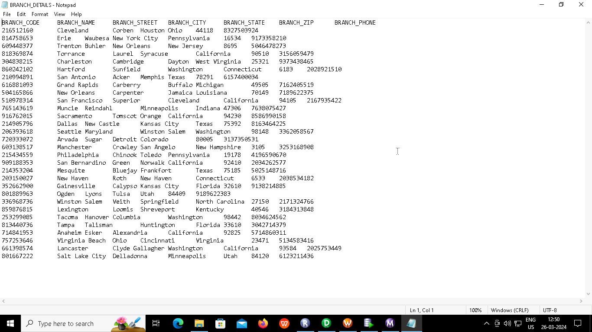
Branch Source data

Slide 7
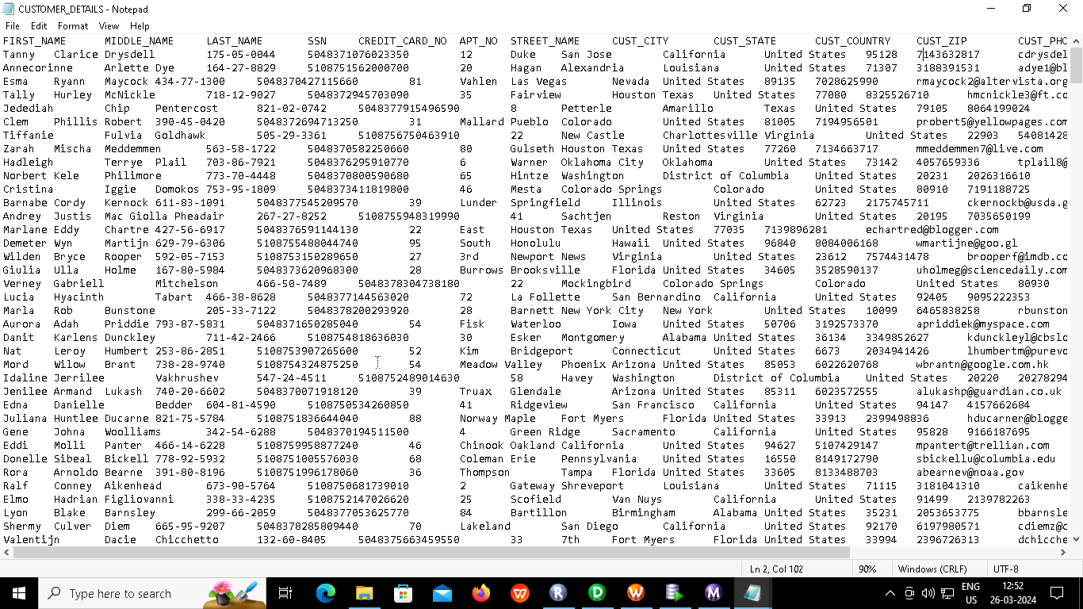
Customer Source data

Slide 8
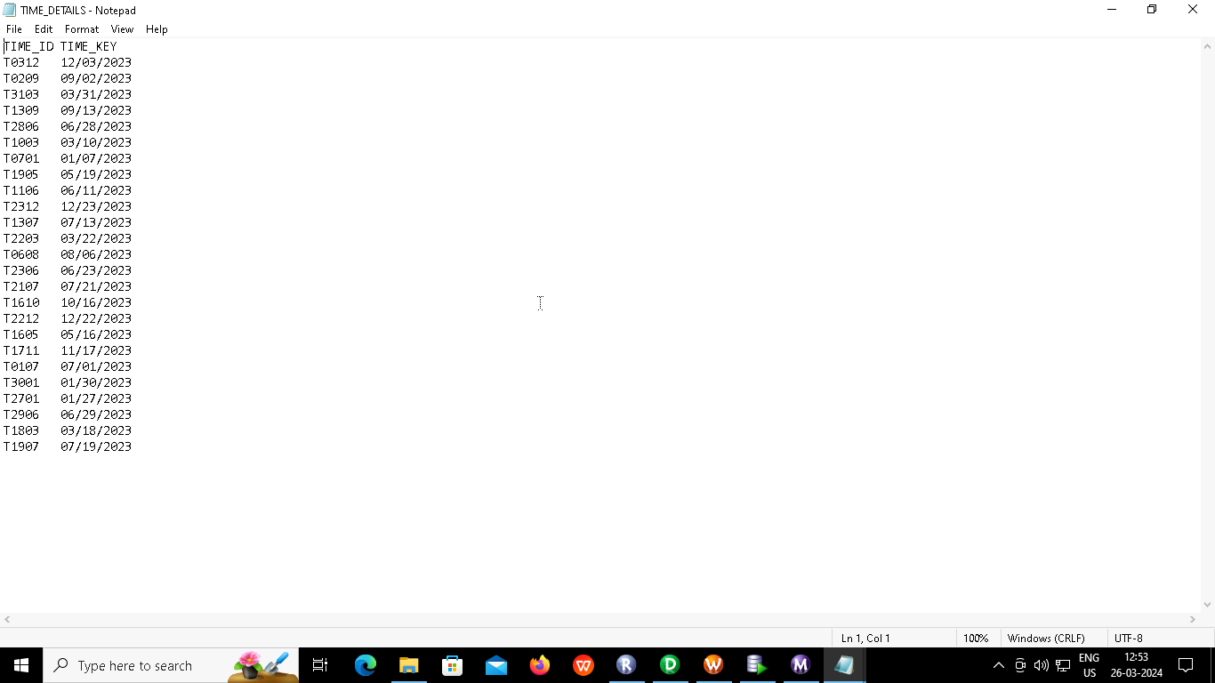
Time Source data

Slide 9
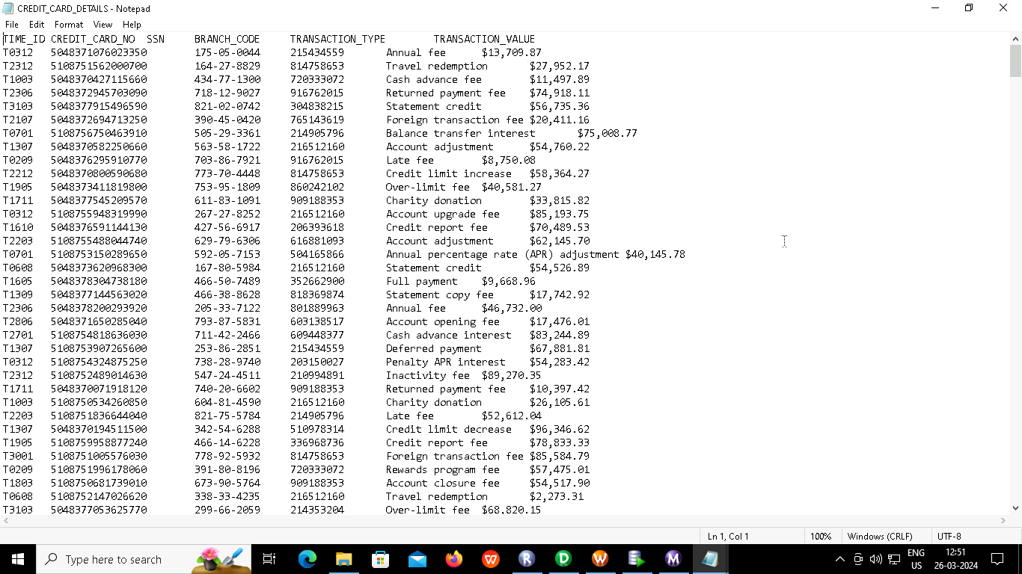
Credit_Card Source data

Slide 10
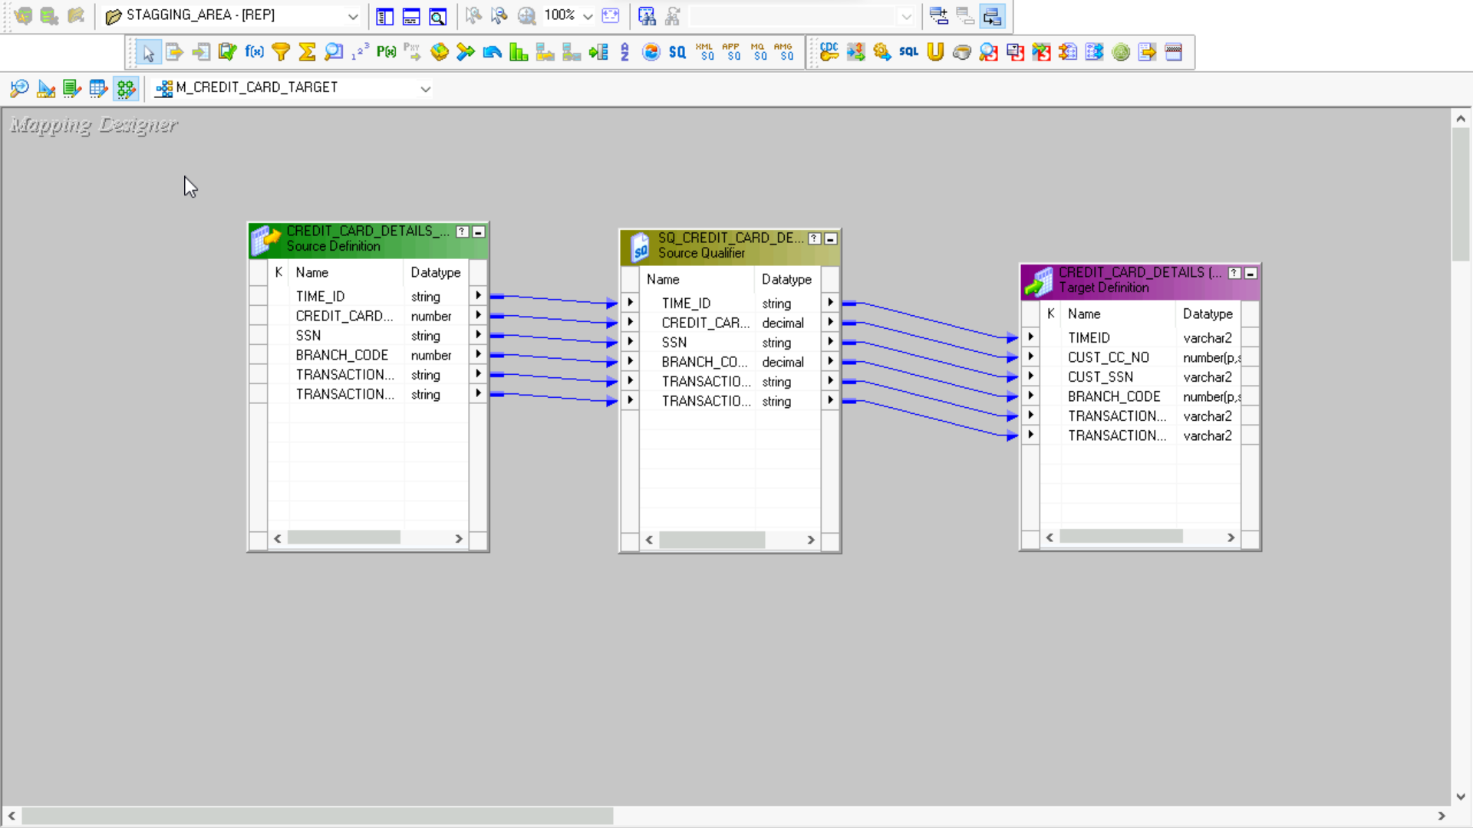
Stagging area mapping:

Slide 11
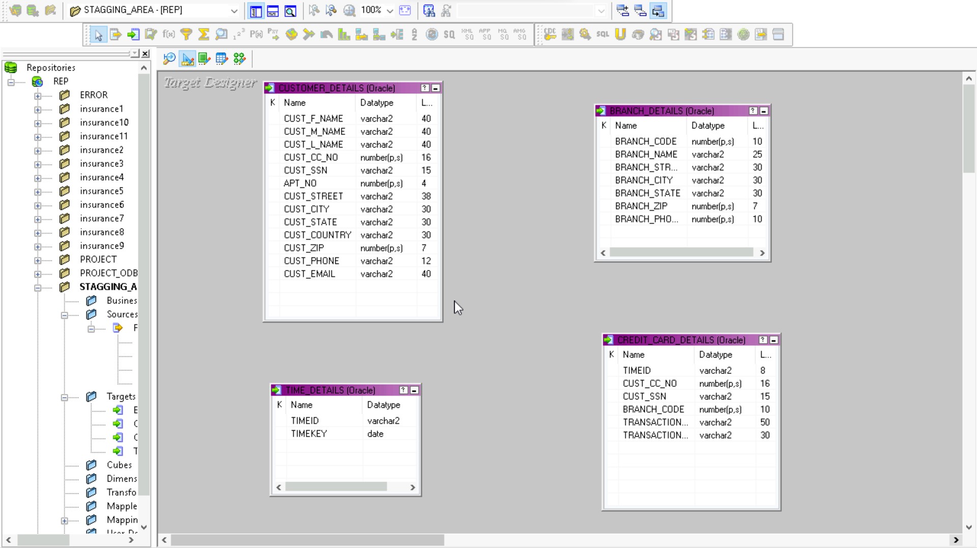
Staging Area Targets

Slide 12
Mappings
4 mapping for transferring data from source file to staging area
4 mapping for bringing data from staging area to target
Contains various transformations like expression, lookup,update strategy etc
Dimension table mappings implemented by SCD1

Slide 13
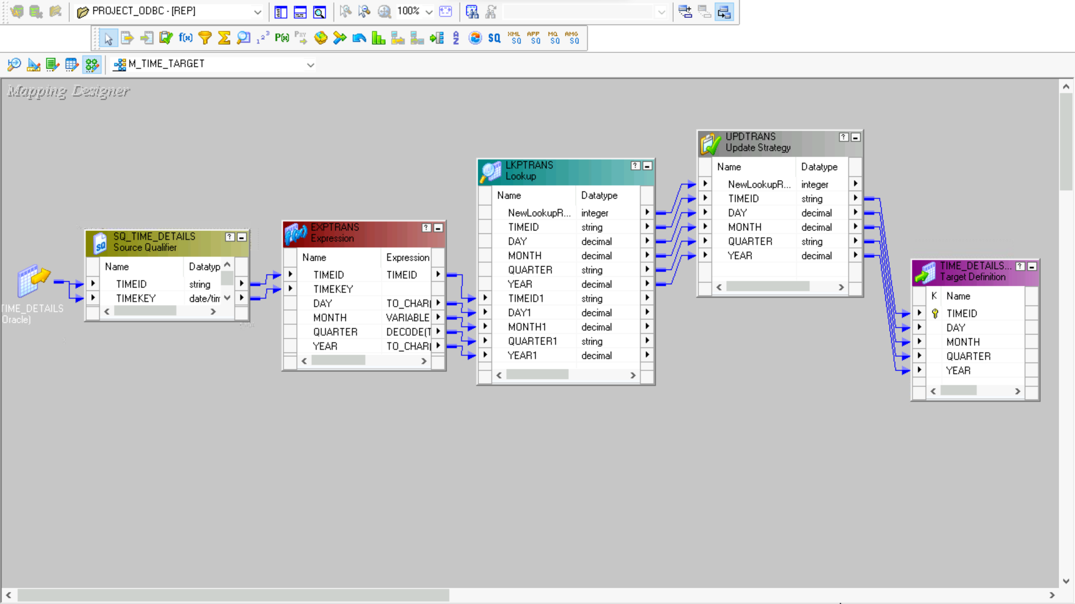
TIME_DETAILS_TARGET

Slide 14
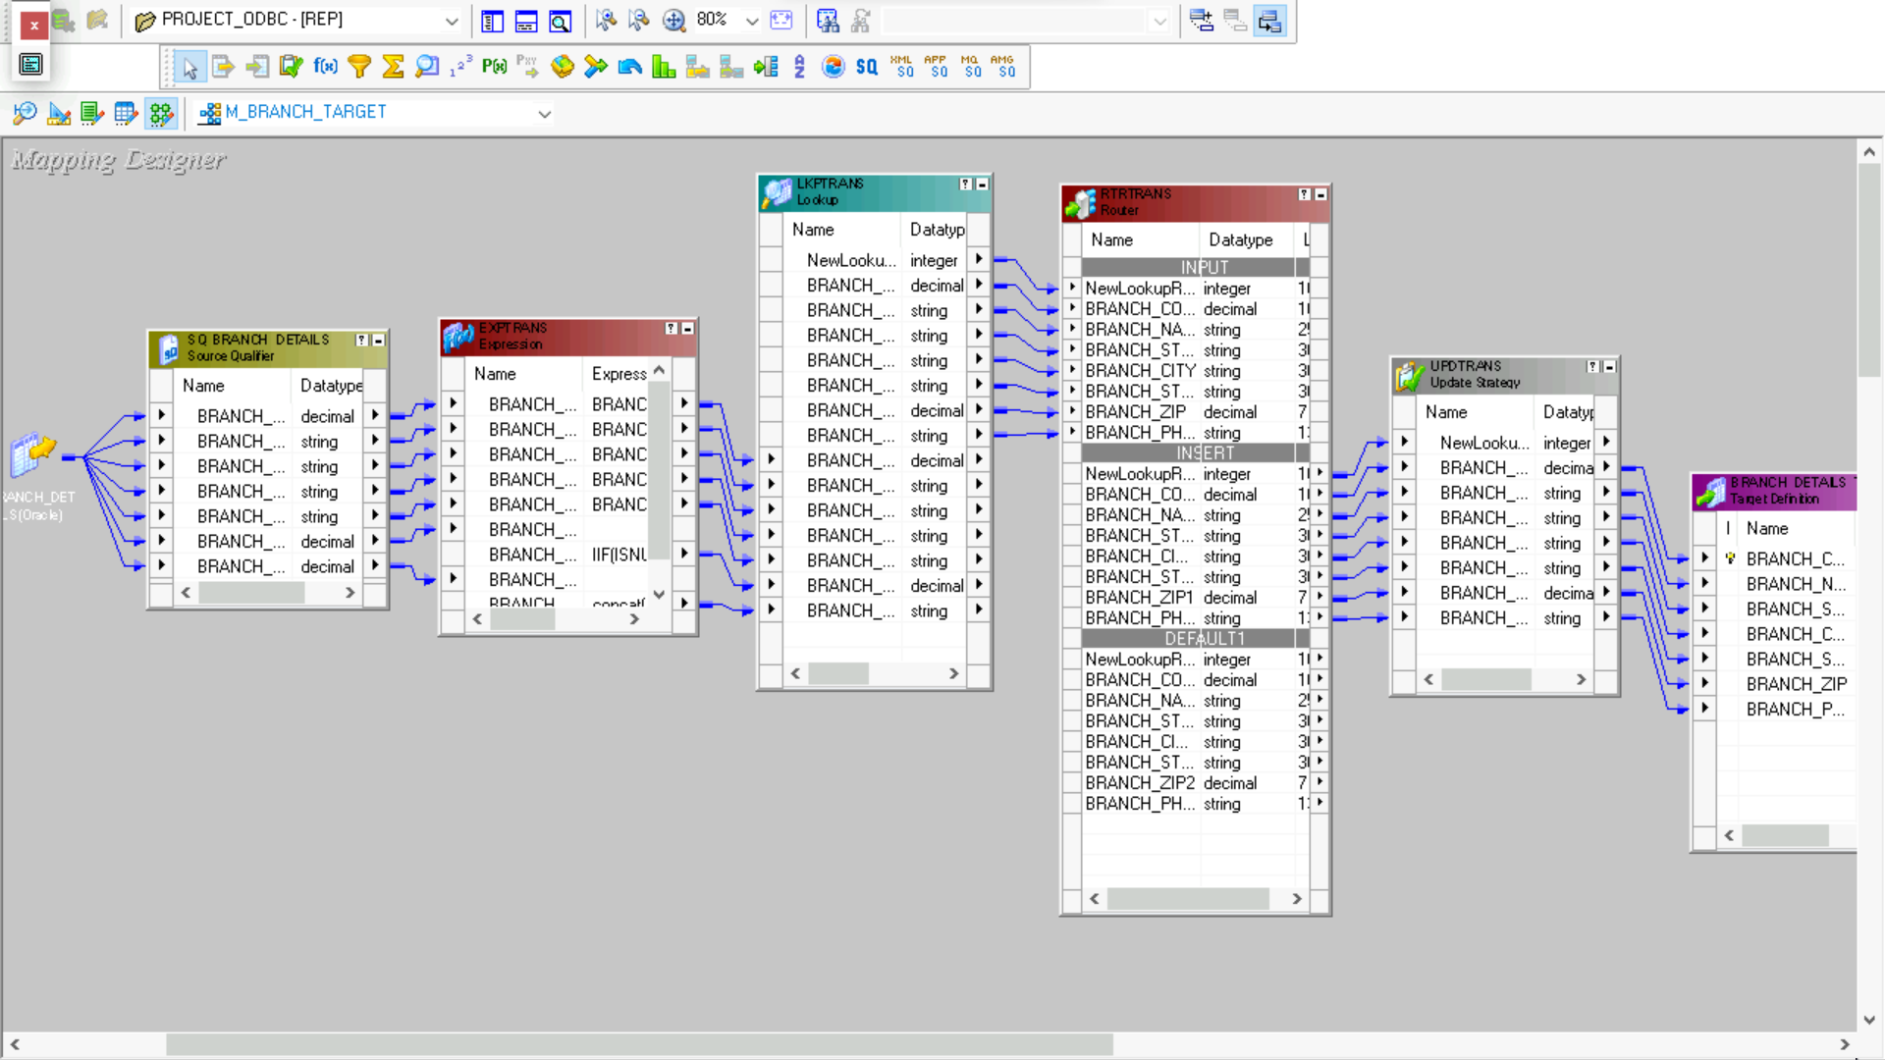
BRANCH_DETAILS_TARGET

Slide 15
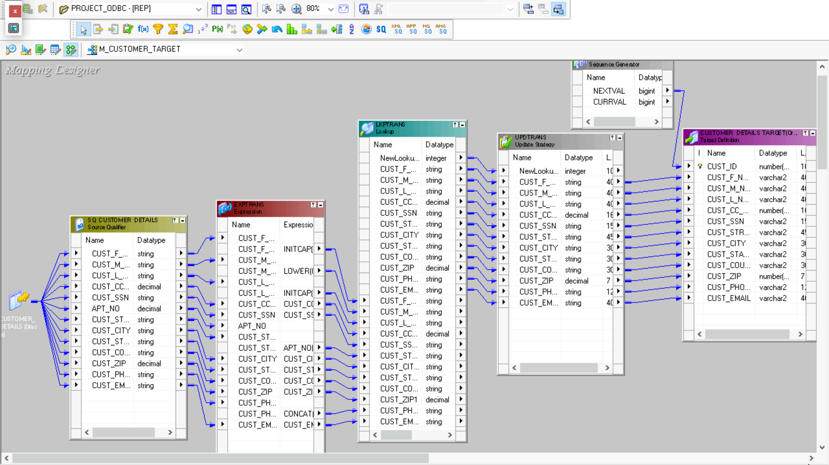
CUSTOMER_DETAILS_TARGET

Slide 16
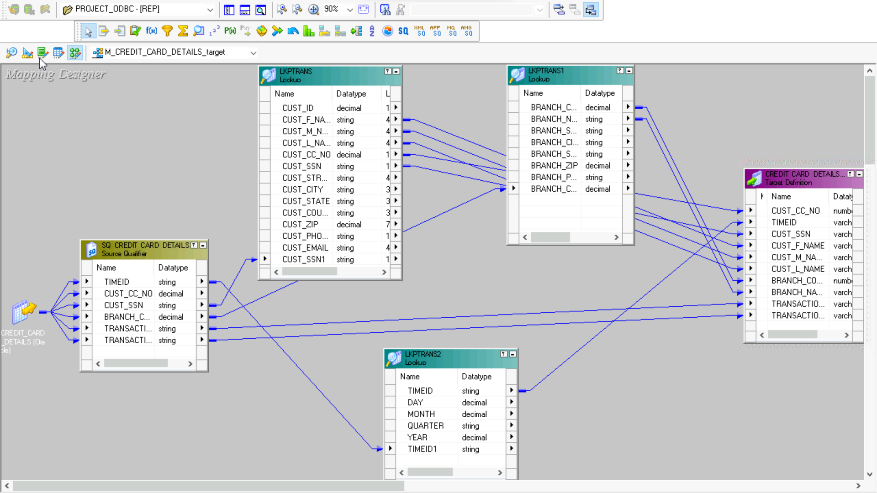
CREDIT_CARD_DETAILS_TARGET

Slide 17
About Target
After performing various transformations the data is loaded in RDBMS tables
3 Dimension tables naming BRANCH_DETAILS_TARGET, CUSTOMER_DETAILS_TARGET, TIME_DETAIL_TARGET
1 Fact table named CREDIT_CARD_DETAILS_TARGET
Implementing SCD1 for dimension tables

Slide 18
Work flows
Responsible for running the mapping with proper set of rules
2 Workflow has been used:
1st for loading in Staging Area.
2nd for loading in Data Warehouse.
4 parallel sessions are created for the workflows.

Slide 19
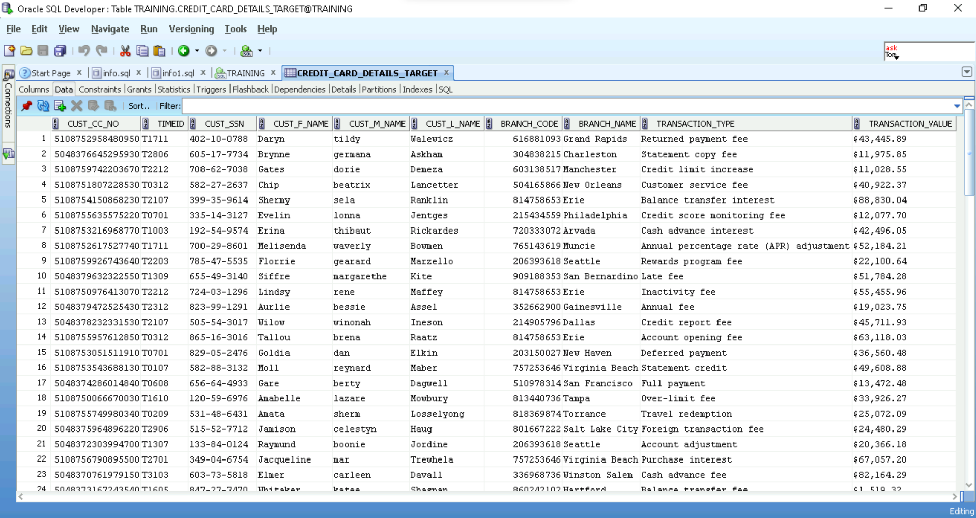
OUTPUT FILE

Slide 20
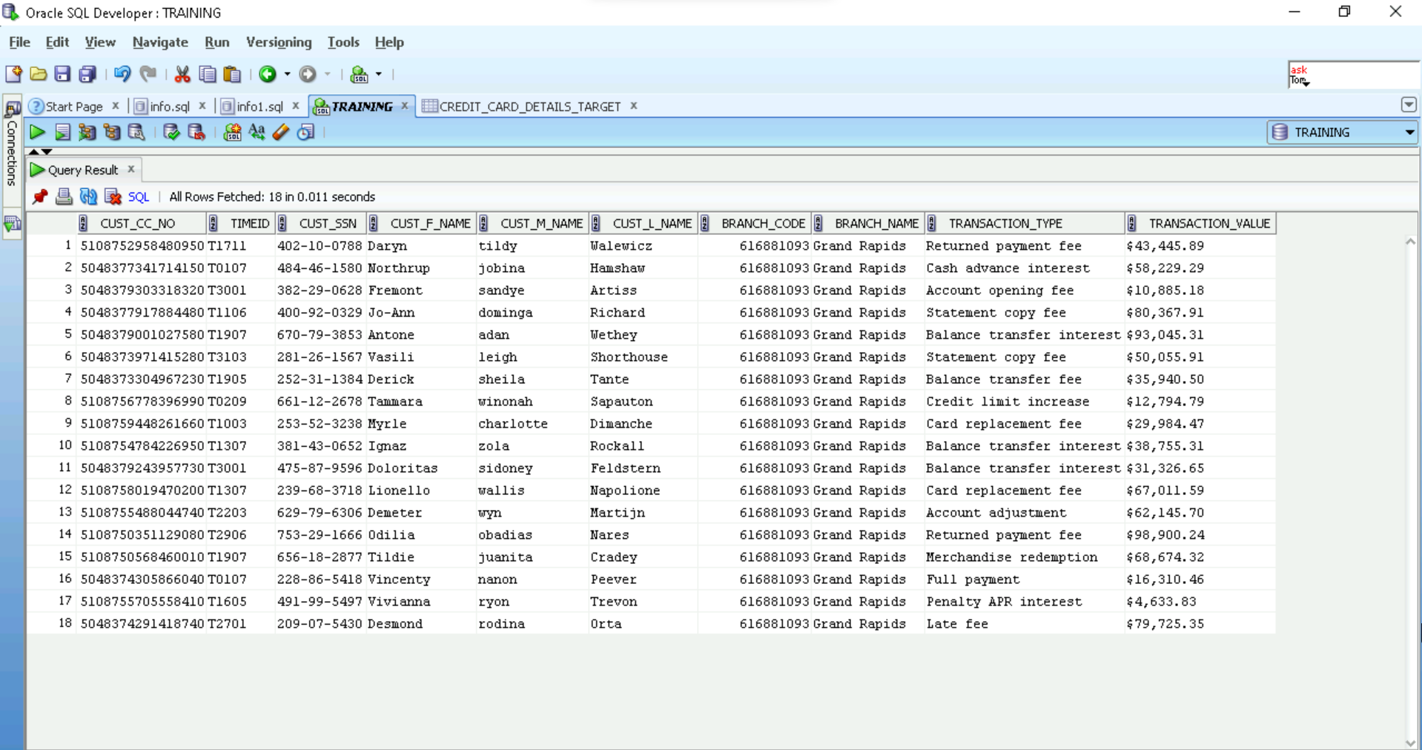
OUTPUT FILE BASED ON BRANCH CODE

Slide 21
THANK YOU

